Slide 1
Performance analysis of channel estimation and adaptive equalization in slow fading channel
Chen Zhifeng
Electrical and Computer Engineering
University of Florida

Slide 2
Outline
System Model and Main Techniques
Simulation and Experimental Result
Possible Improvement
Future work
My Questions

Slide 3
System Model and Main Techniques
Flow chart diagram
Build up our model
Produce data and set parameters
Produce different channels
Channel estimation for flat fading
Equalization for frequency selective fading

Slide 4
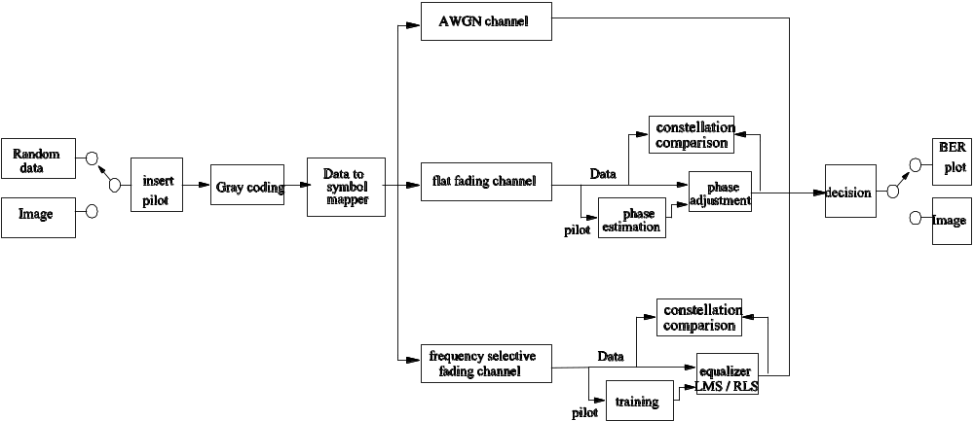
Flow chart diagram

Slide 5
Build up our model
For slow fading, Ts<<Tc
For flat fading, Ts>>σ_{τ}
For frequency selective fading, Ts < σ_{τ}
So we get:
  σ_{τ} <<Ts<<Tc for a slow flat fading channel
  Ts< σ_{τ} <Tc for slow frequency selective fading channel.

Slide 6
Build up our model --Cont.
Two Scenarios: Urban and Suburb
Suppose in both environments, there are no dominant stationary signal component, such as light-of-sight path , i.e. Rayleigh fading
To simulate GSM:
  Carrier frequency: fc = 1.8GHz
  Bandwidth of each channel: 200KHz
  Symbol period: Ts = 5us for Nyquist pulse

Slide 7
Build up our model --Cont.
First scenario – urban environment
  RMS delay spread σ_{τ}= 10 us (in Rappaport)
  Suppose walking at: 5km/hr
  Coherence time Tc = 9/(16*pi*fm) = 21.5ms
  Ts (5us) < σ_{τ} (10us) < Tc (21.5ms)
  So, it is a slow frequency selective fading channel

Slide 8
Build up our model --Cont.
Second scenario – suburb environment
  RMS delay spread σ_{τ}= 300 ns (in Rappaport)
  Suppose on a train at: 20-120km/hr
  V = 20km/hr ➔ fm = fc*V/C = 33.3Hz
    Coherence time Tc = 9/(16*pi*fm) = 5.4ms
    σ_{τ} (300ns) < Ts (5us) < Tc (5.4ms)
  V = 120km/hr ➔ fm = fc*V/C = 200Hz
    Coherence time Tc = 9/(16*pi*fm) = 900us
    σ_{τ} (300ns) < Ts (5us) < Tc (900us)
  So, they are both slow flat fading channel

Slide 9
Produce data and set parameters
Support random data and image data
Modulation: Phase shift keying (PSK)
  In our simulation, use QPSK
May use Gray coding or not
8% pilot data is inserted preceding source data in each coherence time

Slide 10
Produce different channels
AWGN: r = s + n
Slow flat Fading r = s.*h + n
Slow frequency selective fading r = s.*h + n

Slide 11
Channel estimation for flat fading
Estimate the channel phase for PSK modulation
Use first 8% data to training the detector
  Tc/Ts = 1080 @ 20km/hr → 86 pilot data
  Tc/Ts = 180 @ 120km/hr → 14 pilot data
Use the mean of phase shift in the pilot to adjust the received signal phase

Slide 12
Equalization for frequency selective fading
Use first 8% data to training the equalizer
  Tc/Ts = 4300 @ 5km/hr → 344 pilot data
Support linear equalization: LMS & RLS
Support training only and decision directed
Support reset equalizer weights or not before beginning a new training cycle in next coherence time

Slide 13
Simulation and Experimental Result
For AWGN channel
For slow flat fading channel
For slow frequency selective fading channel
Comparison among three channels

Slide 14
For AWGN channel
1) BER of simulation vs theoretical
  The BER performance of simulation result is closely identical to theoretical BER.
2) Image quality of received vs original
  the received image is plot at SNR = 5dB, we see there are some random noises in the image. From simulation result, the received image quality is almost the same as original at SNR = 10dB.
3) BER of Image vs random data
  The correlation between image pixel does not effect the BER in AWGN channel.

Slide 15
For slow flat fading channel
1) BER of simulation vs theoretical
  the BER performance of simulation result is worse than theoretical BER since we do not know exactly the channel phase information
  BER performance is improved dramatically in low SNR, while not in high SNR. Since in low SNR, white Gaussian noise dominate the BER error, which can be improved by enhancing SNR; while in high SNR, phase estimation error dominate the BER error, which can not be improved by simply enhancing SNR.
2) BER & constellation of training vs non-training
  the constellation is plot at SNR = 25dB, we see both the BER performance and constellation are greatly improved by channel phase estimation.

Slide 16
For slow flat fading channel –Cont.
3) Image quality of received vs adjusted
  the received image is plot at SNR = 25dB, we see that other than some random noise, there is some block noise in the image. This is due to the phase estimation error in a coherence time.
4) BER of Image vs random data
  The correlation between image pixels does not affect the BER in flat fading channel.

Slide 17
For slow frequency selective fading channel
1) BER of simulation vs theoretical
  BER performance of simulation result is worse than theoratical BER. The reason is same from above reason addressed in flat fading channel.
  Different from in flat fading channel, the BER performance is improved dramastically in low SNR, while even degraded in high SNR. This is also reasonable, since in high SNR, phase estimation error and ISI dominate the BER error, and the estimation error will cause even severe ISI., which cause the BER even worse.
2) BER & constellation of training vs non-training
  the constellation is plot at SNR = 25dB, we see both the BER performance and constellation are greatly improved by channel phase estimation.

Slide 18
For slow frequency selective fading channel –Cont.
3) Reset vs continue training result
  BER performances of resetting the state of equalizer come from training result of last coherence time is worse than using the result of last coherence time.
4) Training only vs decision directed mode
  BER is improved by using decision directed mode, since the time-variant property of the channel cause the channel change from estimation result of training data.
5) LMS vs RLS
  BER performances are almost same for both of them
  LMS need more training data to converge the equalizer comparing to RLS
  RLS has more complexity and time consuming.

Slide 19
For slow frequency selective fading channel –Cont.
6) Image quality of received vs original
  received image is plot at SNR = 25dB, we see that other than some random noise and block noise in the image, there are some overlaps in the image. This is due to the whilte Gaussian noise, phase estimation error in a coherence time, and ISI caused by frequency selective fading channel.
7) BER of Image vs random data
  The correlation between image pixels does not effect the BER in frequency selective fading channel.

Slide 20
Comparison among three channels
1) For Image comparison
  in AWGN channel, the image is degraded by random noise; in flat fading channel, the image is degraded by random noise and block noise; in frequency selective fading channel, the image is degraded by random noise, block noise, and overlap.
2) For BER performance comparison
  BER performance is best in AWGN channel, worse in flat fading channel and worst in frequency selective fading channel. They are exactly as the theoretical analysis.

Slide 21
Possible Improvement
In flat fading channel, we training the detector by the pilot data in the head of source data in each coherence time.
But the channel is time-variant even during one coherence time, so in our future simulation, we may use different interpolation algo-rithms between different coherence time to improve the esti-mated channel phase and amplitude informance.

Slide 22
Possible Improvement –Cont.
We use linear equalizer in our present model. As well know, linear equalizers do not perform well on channels which have deep spectral nulls in the passband.
While frequency selective fading channel normally cause the deep spectral nulls, so in our future simulation, we may improve this by add Decision Feedback Equalization (DFE).

Slide 23
Future work
In this project, we choose PSK modulation to test the effect of different channels to the received data. So, we only use estimate the channel phase information.
We may add more modulation techniques in our model, such as ASK and QAM with different modulation orders. Then we will need to estimation both the channel phase information and amplitude information.

Slide 24
Future work –Cont.
In this project, we produce two different scenarios by simulate a GSM carrier frequency and bandwidth, and use pilot data to estimate the channel phase. All of these are simulated in Matlab at present.
In our future model, we may integrate our model into Qualnet, which will give a better environment to simulate a wireless network model.

Slide 25
Future work –Cont.
In next project, we will integrate the project with last project, i.e. GNU Radio project, and test our algorithm on the practical communication system.
We need to do some revision based on the practical system, such as add differential coding due to asynchronization, add pulse shaping, etc.
We will add link layer protocol into the practical system, and test our algorithm.

